Slide 1
Web Basic and Technology Environment
Cyber Security

Slide 2



Web Technology Concept
Client
User-agent: Firefox
example request
GET / HTTP/1.1
Host: www.tamk.fi
User-Agent: Mozilla/5.0 (Mac..)
...
Server
Apache HTTP Server
response
PHP
Database
MySQL

Slide 3
Apache HTTP Server Overview
Free, Based On Open Source Technology.
Multiple Scripting Language Support.
Runs On * Operating Systems.
Web Server With a modular design.
Simple, Powerful file-based configuration.

Slide 4
Apache Configuration File
httpd.conf
access.conf ( linux )
.htaccess
.htpasswd

Slide 5
Core Apache Configuration Directives
ServerRoot :: Apache Installation Directory Path.
  ServerRoot “e:/apache2.2.11"
▪ Listen :: IP addresses and ports that the server listens.
Listen 80
Listen 192.1.1.132:9111

Slide 6
Core Apache Configuration Directives
▪ ServerAdmin :: Email Address that will be displayed in
the error message when error occurs
ServerAdmin binus@gmail.com
ServerName :: Current Server Name & Port
  ServerName localhost:80
ServerAlias :: Alternate Names for accessing virtual hosts.
ServerAlias alias-1 alias-2

Slide 7
Core Apache Configuration Directives
▪ DocumentRoot :: Main Document Directory as displayed on the Web Site.
DocumentRoot “E:/wwwroot”
▪ NameVirtualHost :: Designates an IP address for name-virtual host
NameVirtualHost *:2125 NameVirtualHost 10.0.2.132:9111

Slide 8
Core Apache Configuration Directives
LoadModule :: Load Specific Apache Module.
  LoadModule test_module modules/mod_test.so
▪ Include:: Includes other configuration files in the server configuration file.
  Include “test.conf”
  Include “e:/wwwroot/aliases/*.conf”

Slide 9
Core Apache Configuration Directives
IFModule :: Allows Module Specific Configurations.
  <IfModule module_name>
  Module Specific Configurations
  </IfModule>
  <IfModule !module_name>
  Module Specific Configurations
  </IfModule>

Slide 10
Core Apache Configuration Directives
Directory :: Allows group of directives applied to directory
<Directory “E:/wwwroot/">
List of directives... ................... ....................
</Directory>

Slide 11
Core Apache Configuration Directives
Access Control Directives ::
Determines who is allowed to access the website and who is kept out.
Access can be granted based on following criteria ::
IP Address / Domain Name
Date & Time
Other User Defined Criteria

Slide 12
Core Apache Configuration Directives
▪Order :: Defines ordering for allow & deny
    Order Allow,Deny
    Order Deny,Allow
▪Allow :: Allows access from given IP Address or Domain Name
    Allow From all
    Allow From 192.168
▪Deny :: Deny access from given IP Address or Domain Name
Deny From 192.168
    Order Allow,Deny
    Allow list will be processed first, followed by Deny list
    Order Deny,Allow
    Deny list will be processed first, followed by Allow list

Slide 13
Core Apache Configuration Directives
Apache Configuration File::
  <Directory “E:/wwwroot/protected”>
  Order allow,deny Allow from all
  Deny from 192.168.
  </Directory>
.htaccess ::
  Order allow,deny
  Allow from all
  Deny from 192.168.

Slide 14
Core Apache Configuration Directives
▪ FileMatch :: Allows to define Access Rights for specific files.
    <FilesMatch "^\.ht">
      Order allow,deny
      Deny from all
    </FilesMatch>
    <FilesMatch "\.pdf$">
    Order allow,deny
    Deny from all
    </FilesMatch>

Slide 15
Core Apache Configuration Directives
▪AuthType :: Type Of User Authentication
AuthType Basic | Digest
▪AuthUserFile :: File name which contains username and password AuthUserFile <Directory>/FileName

Slide 16
Core Apache Configuration Directives
▪ AuthName :: Authorization Title used in HTTP Authentication
AuthName Authentication Title
▪ Require :: Defines Type of Users/groups that can access Contents. Access Types can be :: group | user | valid-user.
Require [Access Type] [ Access Name ]
Require group admin

Slide 17
Virtual Host
Allows more than one websites to run on the same server (Apache Server)
Two Types Of Virtual Hosts can be created:
IP-based Virtual Hosts
Name-based Virtual Hosts

Slide 18
Virtual Host Related Directives
<VirtualHost [IP ADDRESS:PORT] >
  ServerAdmin
  DocumentRoot
  ServerName
  ServerAlias
  ErrorLog
</ VirtualHost >

Slide 19
Common Virtual Host Example
Listen 2125
NameVirtualHost *:2125
<VirtualHost localhost:2125>
ServerAdmin binus@gmail.com
DocumentRoot "E:\wwwroot\zfBasics"
ServerName localhost
</VirtualHost>
  Listen 9111
  NameVirtualHost *:9111
<VirtualHost *:9111>
ServerAdmin binus@gmail.com
DocumentRoot "E:\wwwroot\addressbook“
</VirtualHost>

Slide 20
Error Handling
Apache Server generates Status Codes depending on the Page/URL Request.
301 Moved Permanently 401 Unauthorized
403 Forbidden
404 Not Found
500 Internal Server Error

Slide 21
Error Handling
ErrorDocument :: Allows to define Custom Error Pages
ErrorDocument StatusCode <Custom Error Page Location> ErrorDocument 401 /error401.html
ErrorDocument 403 /errordocs/error403.php
ErrorDocument 404 http://www.yousite.com/error.php

Slide 22
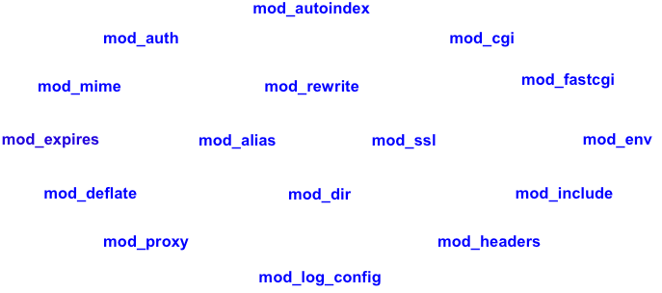
Important Apache Module

